Slide 1
Capstone Project Stack Route ML Wave 1

Slide 2
Question Answering System

Slide 3
Problem Statement
Build a Q&A system to hold conversation over a closed domain with following modules:
Auto completion of user queries. Prediction of next set of words based on previous words.
Co-referencing solution for multiple short sentences.
Understanding the real intention of the user by asking more questions
Summarizing the queries done by a person during a session.
Objectives:
Trainability
Scalability

Slide 4
Dataset
SQuAD
Data: Stanford Question Answering Dataset (SQuAD) is a new reading comprehension dataset, consisting of questions posed by crowdworkers on a set of Wikipedia articles, where the answer to every question is a segment of text, or span, from the corresponding reading passage. With 100,000+ question-answer pairs on 500+ documents,
Challenge: Given a context (a passage) point to an answer from within
Our Challenges
Finding an answer from 442 documents, 24K passages, 2M sentences and more than 20M words
At document level the complexity is 24K times more than the SQuAD dataset

Slide 5
Problem Scoping
Build a Q&A system to hold conversation over a closed domain with following modules:
Auto completion of user queries. Prediction of next set of words based on previous words.
Co-referencing solution for multiple short sentences
Understanding the real intention of the user by asking more questions
Summarizing the queries done by a person during a session
Pointing to a correct document →paragraph→ sentence→span when a query is asked and come up with a optimum solution.

Slide 6
Architecture
IR
Parse & Analyze
AutoFill
Question
Answer Selection
Retrieval Analysis
Response
{Answer}
Corpus
Document Tagger
Annotated corpus

Slide 7
Executive Summary - Autofill
Predict next word/sentence so as to:
Improve both precision and recall
Save user time
Discover the knowledge base
Approach:
N-Grams
Various RNN architectures

Slide 8
Executive Summary - Information Retrieval
Given a query:
Point to a document
Point to a paragraph
Point to a sentence
Approach:
Learning to rank using an ensemble of:
TF-IDF, BM25, Doc2vec
Word Mover Distance (with and without attention model)
DNN

Slide 9
Executive Summary - Answer Selection
Point to a span, given a context using Bidirectional Attentional Flow Models

Slide 10
AUTOFILL (Auto completion of user’s question or queries)

Slide 11
Problem Statement
Design a model that recommends the next word(s) within a closed domain from a set of words given by the user.
OBJECTIVE
The primary goal is to constrain the questions to our knowledge domain and hence avoid any ambiguity in finding answer.

Slide 12

Week
Analysing and discussing the project requirements.
Data gathering.
Data Preprocessing.
Surveying existing models
Training N-gram model.
Project Timeline
1
Embedding layer design
Working on various DNN models using LSTM.
2
3
Testing LSTM models with different hyperparameters

Slide 13
Flow/Approach
Data Gathering
N- gram generation
Data Preprocessing
Data Embedding
Training a Neural Model
Prediction using
Back-off
Prediction
Evaluation

Slide 14
Pre-Processing
Data gathering
SQuAD Data consists of 100,000+ questions-answers on a set of Wikipedia articles. Total vocabulary size 52000+ words
Wikipedia Data Complete 48 wikipedia articles on SQuAD topics

Slide 15
Pre-Processing
Cleaning text
Removing special characters.
Removing punctuations
Data Manipulation
Replacing Named Entity with single word.
Tokenize
Sentence tokenize
Word tokenize

Slide 16
Flow/Approach
Data Gathering
N- gram generation
Data Preprocessing
Data Embedding
Training a Neural Model
Prediction using
Back-off
Prediction
Evaluation

Slide 17
N-gram Model
Estimate probability of each word given prior context.
P(played|when was super bowl)
In general, N-gram model uses only N-1 words of prior context
Unigram: P(played)
Bigram: P(played|bowl)
Trigram: P(played|super bowl)

Slide 18
N-gram Model
Markov assumption The future behaviour of a dynamical system only depends on its recent history. In particular, in a kth-order Markov model, the next state depends only on the k most recent states. P(played|when was super bowl) ~ P(played|super bowl) ~ P(played|bowl)

Slide 19
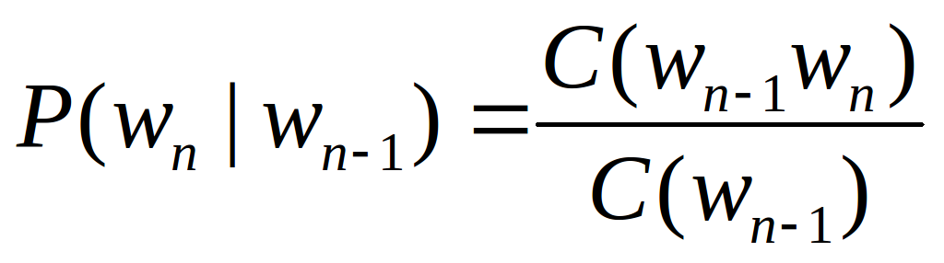
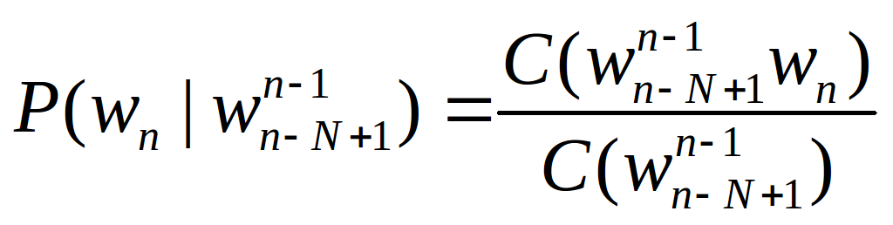
N-gram Model
N-gram conditional probabilities can be estimated from raw text based on the relative frequency of word sequences.
Bigram :
N-gram :
We have used ConditionalFreqDist() and ConditionalProbDist() from nltk.probability to compute the N-gram conditional probability

Slide 20
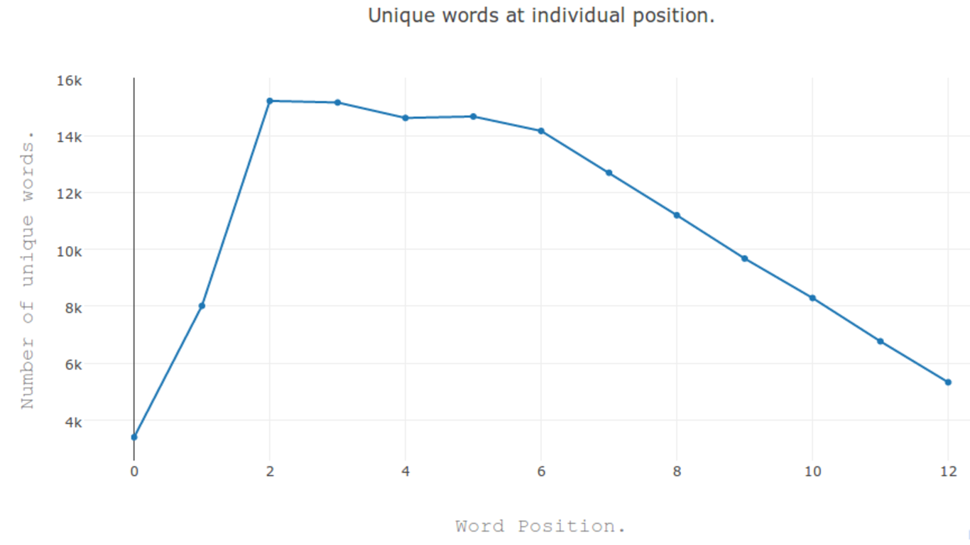
N-gram Model

Slide 21

N-gram Model
As N increases, the power of an N-gram model increases, but the ability to predicate accurate word from sparse data decreases.
Possible solution in Backoff approach
Only use lower-order model when data for higher-order model is unavailable (i.e. count is zero).
Recursively back-off to weaker models until data is available.

Slide 22
N-gram Model
Many times local context does not provide the most useful predictive clues, which instead are provided by long-distance dependencies.
Syntactic dependencies “The man next to the large oak tree near the grocery store on the corner is tall.” “The men next to the large oak tree near the grocery store on the corner are tall.”
Semantic dependencies “The bird next to the large oak tree near the grocery store on the corner flies rapidly.” “The man next to the large oak tree near the grocery store on the corner talks rapidly.”

Slide 23
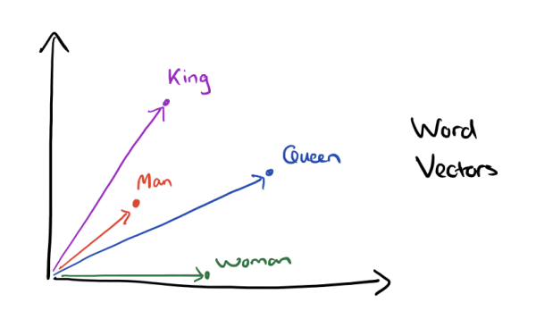
Approach - DNN
Data Embedding
Training gensim word2vec on our data.
Intersecting it with google word2vec and generating vocabulary.
King - Man + Woman = Queen

Slide 24
Sliding Window Approach
Raw Text -> “ Tesla's induction motor and transformer was licensed by whom? ”
Tokenize Text -> [ [“Tesla's”] [“induction”] [“motor”] [“and”] [“transformer”] [“was”] [“licensed”] [“by”] [“whom “] ]
Window size = 4
Input Seq Output Seq
[“Tesla's”] [“induction”] [“motor”] [“and”] [“transformer”]
[“induction”] [“motor”] [“and”] [“transformer”] [“was”]
[“motor”] [“and”] [“transformer”] [“was”] [“licenced”]
Each word will be representation in the form of Vector of size 300.
Window size = 5
Input Seq Output Seq
[“Tesla's”] [“induction”] [“motor”] [“and”] [“transformer”] [“was”]
[“induction”] [“motor”] [“and”] [“transformer”] [“was”] [“licensed”]
[“motor”] [“and”] [“transformer”] [“was”] [“licensed”] [“by”]

Slide 25
Many-In Many-Out Approach
Maximum Sentence Length = 10
Raw Text -> “ <start> In what year did Tesla die? </end> ”
Tokenize Text -> [ [<start>] [“In”] [“what”] [“year”] [“did”] [“Tesla”] [“die”] [</end>] ]
Padded Sequence -> [<start>] [“In”] [“what”] [“year”] [“did”] [“Tesla”] [“die”] [</end>] [0] [0]
Input Sequence ->
Output Sequence ->
[<start>]
[“In”]
[“what”]
[“year”]
[“did”]
[“Tesla”]
[“die”]
[</end>]
[0]
[0]
[“In”]
[“what”]
[“year”]
[“did”]
[“Tesla”]
[“die”]
[</end>]
[0]
[0]
[0]

Slide 26
LSTM with sub-samples.
“W5”
Dense Layer
LSTM Layer - 2
LSTM Layer - 2
LSTM Layer - 2
LSTM Layer - 2
LSTM Layer - 1
LSTM Layer - 1
LSTM Layer - 1
LSTM Layer - 1
Embedding Layer-300
“W1”
“W2”
“W3”
“W4”

Slide 27
LSTM with entire sequences.
“who”
“is”
“the”
....
<end>
<end>
LSTM Layer - 3
LSTM Layer - 3
LSTM Layer - 3
LSTM Layer - 3
LSTM Layer - 3
LSTM Layer - 3
LSTM Layer - 2
LSTM Layer - 2
LSTM Layer - 2
LSTM Layer - 2
LSTM Layer - 2
LSTM Layer - 2
LSTM Layer - 1
LSTM Layer - 1
LSTM Layer - 1
LSTM Layer - 1
LSTM Layer - 1
LSTM Layer - 1
Embedding Layer-300
<start>
“who”
“is”
“the”
….
<end>

Slide 28
Model Comparison
Results of various models tried for word prediction
Model | No. of Layer | No. of units in each layer | Epochs | Batch Size | Activation | Accuracy | Custom Accuracy | Threshold for custom accuracy | Word Embedding Size
LSTM w2v | 2 | 1024, 512 | 15 | 128 | relu | 18 | 31 | 0.85 | 300
LSTM w2v | 3 | 1024, 1024, 300 | 30 | 512 | relu | 41 | 53 | 0.85 | 300
LSTM w2v | 2 | 1024, 1024 | 30 | 64 | relu | 15 | 26 | 0.85 | 300

Slide 29
Probability of POS-tags
Part Of Speech Tags Model
Dense Layer
LSTM Layer - 2
LSTM Layer - 2
LSTM Layer - 2
LSTM Layer - 2
LSTM Layer - 1
LSTM Layer - 1
LSTM Layer - 1
LSTM Layer - 1
POS to Index(Categorical)
“Noun”
“Auxiliary Verb”
“Verb”
“Adj.”
Word to POS tags
“W1”
“W2”
“W3”
“W4”

Slide 30
POS-tag Model Comparison
Results of various models tried for word prediction
Model Type | No. of Layers | No. of units in each layer | No. of Epochs | Batch Size | Activation | Accuracy
LSTM | 2 | 1024, 1024 | 30 | 128 | Sigmoid | 46
LSTM | 2 | 256, 256, | 25 | 128 | Sigmoid | 44
LSTM Multiclass | 2 | 1024, 1024 | 10 | 128 | Sigmoid | 12

Slide 31
Challenges
Training Data:
Training DNN on entire SQuAD and wikipedia data → time consuming
Our model → SQuAD’s questions only
Word2vec representation:
Word-vector generated using limited vocabulary → limits model prediction
Intersected our word2vec model with Google’s word2vec model
Retaining Context:
Retaining context with input sequence
Used Many In-Many Out approach in LSTM to solve this problem.

Slide 32
Challenges
Time Constraints:
Very high Training times
limited variation in hyperparameter (no. of layers, layer size, epochs)
Unable to train LSTM stateful model (batch size - entire dataset)
Time : 2 hours per epoch on server
Repeated words in prediction
Possible solution - Ensembling POS-tag model with Word2Vec model

Slide 33
State of the Art Models
Natural Language Generation Model by Andrej Karpathy:
Naturalism and decision for the majority of Arab countries' capitalide was grounded by the Irish language by [[John Clair]], [[An Imperial Japanese Revolt]], associated with Guangzham's sovereignty. His generals were the powerful ruler of the Portugal in the [[Protestant Immineners]], which could be said to be directly in Cantonese Communication, which followed a ceremony and set inspired prison, training.
I've the RNN with and works, but the computed with program of the RNN with and the computed of the RNN with with and the code.

Slide 34
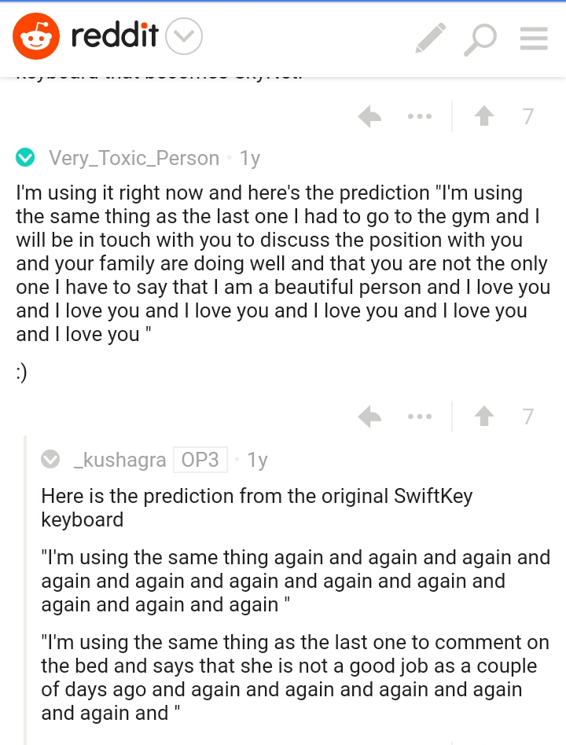

Swiftkey Neural

Slide 35
DEMO
SOURCE CODE LINK - https://github.com/nishant-jain-94/Autofill

Slide 36
Information Retrieval (Point to the right document)

Slide 37
FLOW DIAGRAM
1
P1
Q1
Document 1
P2
Q2
Original
Dataset
Document 2
…..
…..
P55
…..
Q269
Document 442
2
Pre – processing of the data (Removal of stop-words, removal of punctuation marks)
QUERY

Slide 38
TF - IDF
Doc2Vec
BM_25
3
3
3
Document Retrieval
Lookups
Similarity Scores
Similarity Matrix
Distance Matrix
Similarity Scores
Similarity Scores
Similarity Scores
Top n Docs
Top n Docs
Top n Docs

Slide 39
Unsupervised learning TO supervised Learning
Unsupervised learning TO supervised Learning
DNN
Accepts
BM25, TFIDF, DOC2VEC
Scores of ‘n’ documents
4
Top 1 Doc

Slide 40
Sentence1, Sentence2, Sentence3
….
Sentence ‘n’
Predicted Document
5
Query, Sentence1 - Score1
Query, Sentence2 - Score2
…
Query, Sentence ‘n’ - Score‘n’
Paragraph Retrieval
QUERY
(POS Tagging
Word Mover’s Distance)
Top Ranked Sentences
6
Sentence 1
Sentence 2
Sentence 3

Slide 41
FLOW PROCESS:
I. Document Similarity
Pre-processing/Preparing Training data for lookups and training them.
Saving the Document Similarity Lookups for future usage
Evaluation Metrics and Model Comparison
Combining it with a DNN Model
II. Paragraph Similarity
Comparison of different Paragraph Similarity Methods
Implementation of WMD model and predicting the candidate paragraph
REQUIREMENTS

Slide 42
1. Document Similarity
User inputs a query the bot should be able to find the answer within the set of documents in a closed environment. Few possible look-ups are used to cut short the number of documents to be passed to Perceptron or a DNN model.
Few possible Lookups used
Question
Lookups
BM 25, TFIDF, Doc2Vec
DNN
Document
442 Docs
1 Doc
Top 20 docs

Slide 43
1.1 Document Similarity - Preparing the Training data for the models
Once the input text has been processed, it is passed to the model as the training data. Each model works on a different type of input text.
Models
Tokenized Docs
442 Docs
Document
BM_25,
TFIDF
Word
Word
Words
Document
List of Documents
Stop Words Removed
1 Doc
Doc2Vec
Document

Slide 44
1.2 Document Similarity - Saving the Models
For future use and reference the models needs to be saved. Following is the data that each model takes to load on all 442 documents for all 87,432 questions on a typical 8GB RAM Machine :
5 seconds
10 mins
57 mins
Doc2
Vec
BM25
TFIDF
BM 25 Model takes 5 sec or even less to train
Doc2Vec Model takes close to 57 mins to train
TF-IDF Model takes approx 10 mins to train

Slide 45
Points discussed in meetings
Whether to remove stop words or not. How the models will be affected with or without them ?
Without stop-words it gives us the best results and reduces the computational time.
Shall we add questions to our training data or not ?
Yes for the better training model, we need the keywords from the questions too.
Why not use a search engine rather than all of this ?
All of this gives it a human touch, search engines can catch keywords, but we are asking in a question form and then later we are incorporating the learning, building the model from scratch to form a scoring(doc ranking) mechanism, turning this unsupervised learning problem to supervised learning problem. Our ultimate goal is to provide an answer not a document.
DISCUSSIONS

Slide 46
1.3 Document Similarity - Evaluation Metrics (BM_25 IR Metric)
Sentence tokenize followed by word tokenize
Train the IR Metrics after removing stopwords
Documents in Corpus
Query
Documents score
Documents rank

Slide 47
1.3 Document Similarity - Evaluation Metrics (TF-IDF IR Metric)
Scores are generated against all the documents
Dictionary to Corpora
Corpora trained against
IR Metrics
Doc to Dictionary
Documents are ranked and similar documents might be clustered.
The query is processed against the trained IR Metrics

Slide 48
1.3 Document Similarity - Evaluation Metrics (Doc2Vec IR Metric)
Document context tagged along with the title
Doc2Vec model is trained with the tagged documents
Compare the query similarity with the trained model
QUERY
Similar documents ranked upon scores
PREDICTED DOCUMENTS

Slide 49
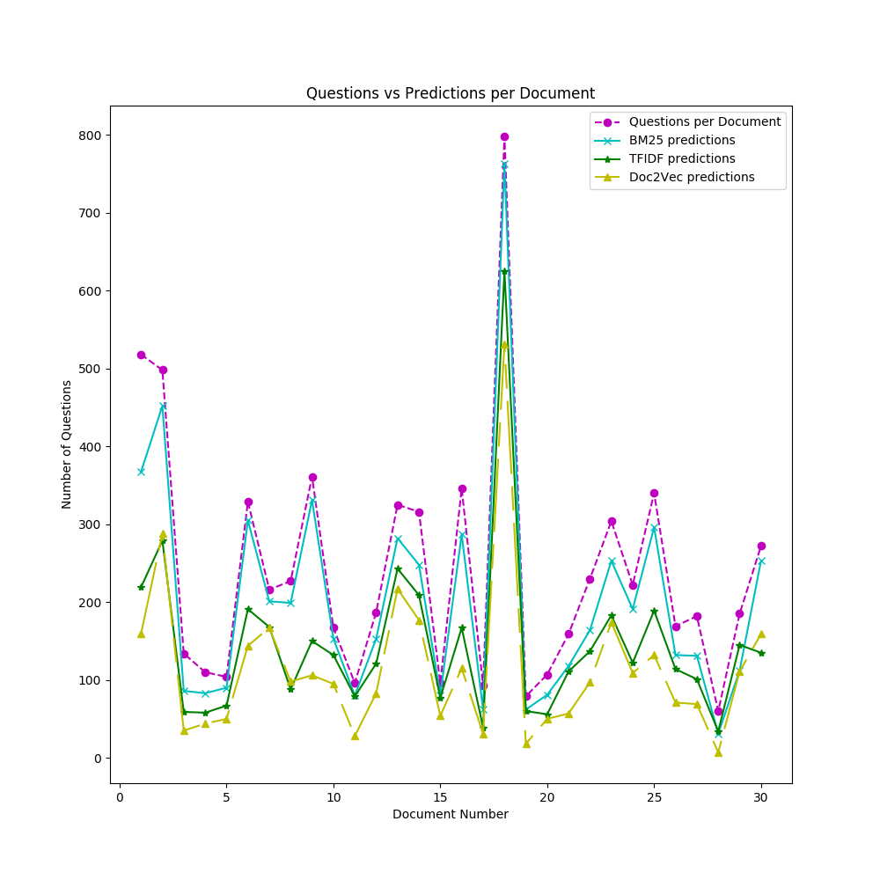
Graph: Question wise comparison of similarity methods
SLIDE
28

Slide 50
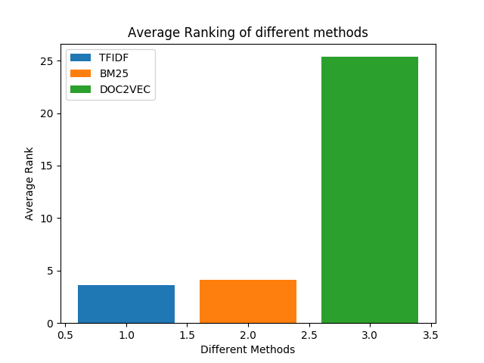
Graph: Mean Ranking of Different Methods
Inferences:
Clear indication of high weightage for TFIDF and BM5 when compared to that of DOC2VEC

Slide 51
Methods we used
QUERY
BM25 + TF-IDF + DOC2VEC
83.92 %
Linear Regression (BM25 , TFIDF, DOC2VEC)
Logistic Regression (BM25 , TFIDF, DOC2VEC)
69.72 %
84.95 %
Logistic Regression (BM25 , DOC2VEC)
81.38 %
Linear Regression Normalized(BM25 , TFIDF, DOC2VEC)
85.05 %
Logistic Regression Normalized (BM25 , TFIDF, DOC2VEC)
86.99%
DNN (BM25 , TFIDF, DOC2VEC + DOC2VEC)
33.33 %
SINGLE PERCEPTRON
(BM25 , TFIDF, DOC2VEC )
63.56 %
Logistic Regression Normalized (BM25 , TFIDF, DOC2VEC) + SINGLE PERCEPTRON(BM25 , TFIDF, DOC2VEC )
89.45 %

Slide 52
1.4 Document Similarity – Combining it with DNNs
Architectural vision for the Document Ranking Problem
TF-IDF
M
O
D
E
L
H
I
D
D
E
N
L
A
Y
E
R
S
O
F
T
M
A
X
L
A
Y
E
R
BM25
Scores of
Doc2Vec
M
O
D
E
L
Doc Embeddings
Output
M
O
D
E
L
Convnet Embeddings

Slide 53
2. Paragraph Similarity
QUERY
Different Methods to Retrieve a Paragraph
Document Retrieval System
Predicted Document
ANSWER
Paragraph of similar lines

Slide 54
2.1 Paragraph Similarity - Comparison of different Methods
DOCUMENT
Only WMD
74 %
Only BM_25
BM_25 Filter + WMD
1.4 %
76 %
P.O.S TAGGED QUERY + WMD
78 %

Slide 55
Word Mover’s Distance (WMD)
Other methods are known to do well but they cannot capture when documents say the same thing in completely different words. For e.g.
Take, for example, two headlines:
- Obama speaks to the media in Illinois.
- The President greets the press in Chicago.
These have no content words in common, so according to most bag of words based method, their distance would be maximal which is wrong!
But WMD model will predict the actual distance.

Slide 56
Word Mover’s Distance (WMD)
Doc: Sentence Tokenized →
Word Tokenize
Query: Word tokenized
Document
Tokenized words of query and docs sent to pre trained WMD model
Query is scored against each sentence and the distance metric is calculated
Paragraph
The least distance sentences above a threshold is chosen.

Slide 57
DEMO
Project Demo -

Slide 58
Answer Selection BiDAF (Bidirectional Attention Flow Model)

Slide 59
Architecture
IR
Parse & Analyze
AutoFill
Question
Answer Selection
Retrieval Analysis
Response
{Answer}
Document Tagger
Corpus
Annotated corpus

Slide 60
AIM
To answer a query about a given context paragraph.
To solve the reading comprehension/question answering problem, we are using attention flow mechanism
Reproducing the BIDAF paper which implements this model

Slide 61
Example
Input:
Context:
Baahubali 2: The Conclusion is a 2017 Indian historical fiction film co-written and directed by S S Rajamouli. The film was produced by Tollywood studio Arka Media Works. It is the continuation of Baahubali: The Beginning, taking place before and after the events of that film. The film stars major actors from Tollywood industry with Prabhas, Anushka Shetty, Rana Daggubati and Sathyaraj in lead roles.
Question:
Who is the director of Baahubali 2?
Network Output:
Start index:16
End index:18
(S S Rajamouli)

Slide 62
BIDAF Model
This model uses attention mechanism to focus on a small portion of the context to select an answer for the given query.
It embeds context and question pair at both word and character level
Multi-task Multi-class classification problem

Slide 63
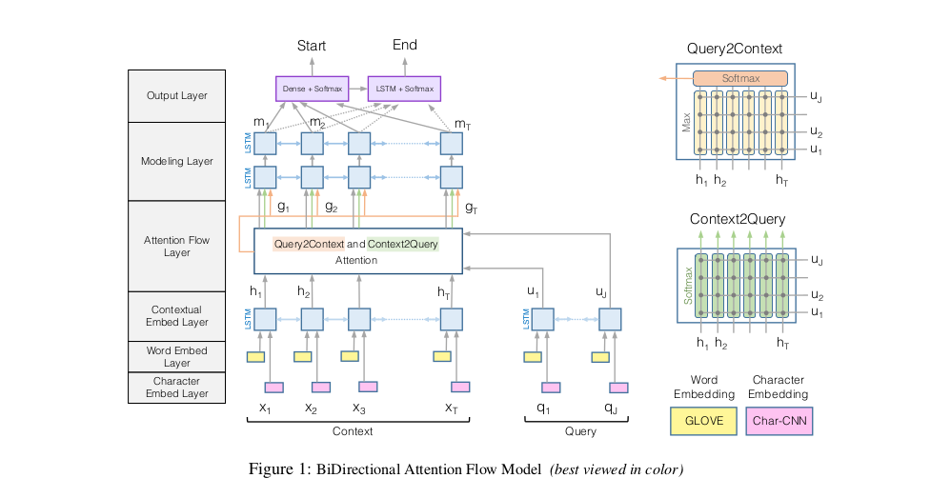
Model Architecture

Slide 64
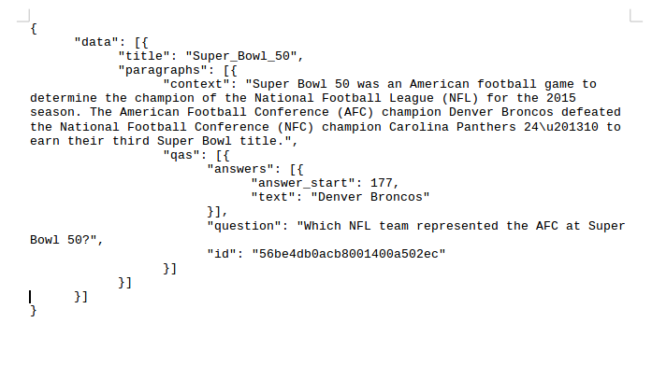
Preprocessing

Slide 65
Steps for Preprocessing
We’ll work with the pre-trained SquAD dataset.
We’ll perform nltk word tokenization on the context and the query and remove certain special characters.
We’ll index all the words in our vocabulary and use those index to create a vector of indexes for each context and query.
For the output, we are producing the span of the answer in the context word level instead of char level.
To make each context and each query of a fixed length we’ll do the padding.
Then save the trained files

Slide 66

L1: Word Embedding Layer
We are using the GloVe vectors to represent each word into a vector of fixed length.
Each word will be represented into a vector of length 100.

Slide 67

L2: Character Embedding Layer
Maps each word to a vector space using char level CNNs.

Slide 68

L3: Contextual Embedding Layer
Utilizes contextual cues from surrounding words to refine the embedding of the words

Slide 69
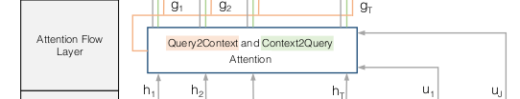
L4: Attention Flow Layer
Couples the query and context vectors and produces a set of query aware feature vectors for each word in the context

Slide 70
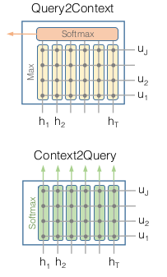
Context2Query
Signifies which query words are more relevant to each context word
h – context
u - query

Slide 71
Query2Context
Signifies which context words have the closest similarity to the query words.
h – context
u - query

Slide 72
L5: Modeling Layer
Contextual information about the word with respect to the entire context

Slide 73
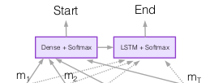
L6: Output Layer
Provides answer to the query

Slide 74
Understanding of Attention Layer in general

Slide 75
AIM
Understand the working of the attention layer in the BiDAF MODEL

Slide 76
What is Attention Model ?
The attention model is used to discover similarities between the context and the query, thereby, finding the most relevant part required for answering the query.
BiDAF uses GloVe and Char embeddings to get the most similar part along with BiLSTM and similarity matrix.

Slide 77
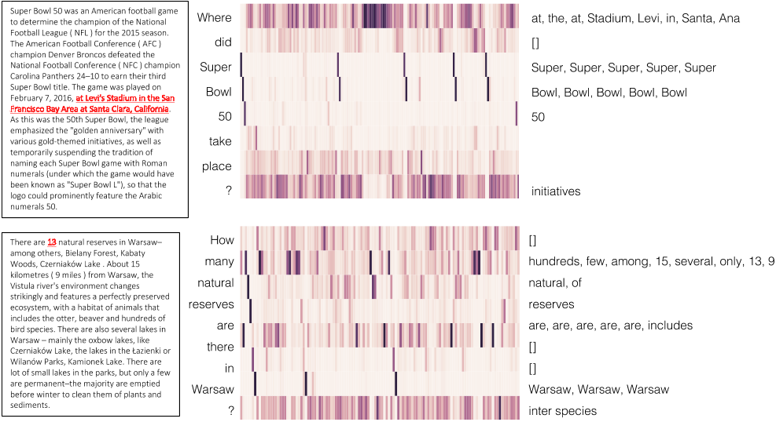
Example

Slide 78
Relationship between Answer and Question Type
Our hypothesis that there must be some relationship between the NER (‘PERSON’,’PLACE’,’DATE’,..etc) tags of answer and Question type(‘WHO’,’WHEN’..etc)

Slide 79
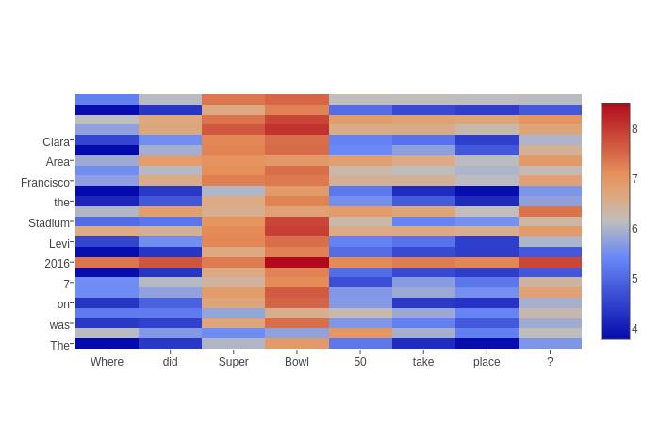
Word Distance of Glove Vectors

Slide 80
Hypothesis
We constructed vectors for the question tags and the sentence NER tags
There must be some relationship between the Question types and NER tags

Slide 81
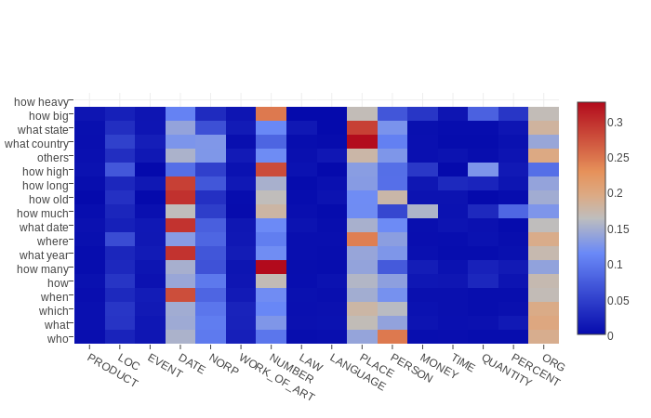
Heat Map(Similarity)
0

Slide 82
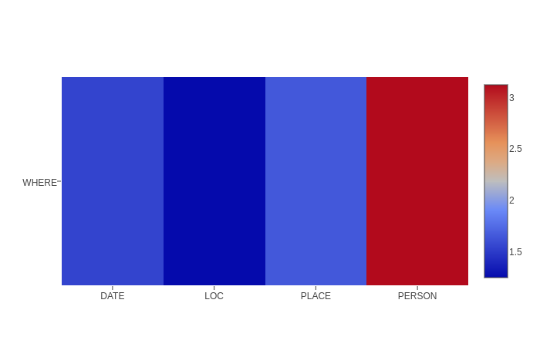
Heat Map (Distance)
Query : ’Where did Super Bowl 50 take place?’
Sentence : ’The game was played on February 7, 2016, at Levi's Stadium in the San Francisco Bay Area at Santa Clara, California’

Slide 83
Summary: Attention Model
Generalised GloVe embeddings to work for the question type and NER tags.
GloVe embeddings and the question type-NER embeddings can be combined to rank the sentences and select the possible answer.

Slide 84
Example
question = 'Who is the President of USA?'
sentence1 = 'Trump, the President of USA is 70 year old'
sentence2 = 'Trump ,likes to play golf'
sentence3 = 'India is a developing nation'
Score 1 = 2.5(Distance)
Score 2 = 4.3(Distance)
Score 3 = 4.9(Distance)

Slide 85
Result and Hyper parameters of the Model
Accuracy –
Training Accuracy – 80.7 %
Testing Accuracy – 81.3 %
Hyper Parameters -
Batch size – 60
Epochs – 12
Dimension of vectors – 512(2d)
Max number of words in context – 866(T)
Max number of words in query – 60(J)

Slide 86
DEMO
Project Demo - http://35.165.153.16:1995/

Slide 87
Other Projects/Modules we worked on during our training
Python Boot-camp – using python text/data analysis modules like pandas, numpy and matplotlib
Python Machine learning modules – sklearn, spicy, keras, surprise, etc.
Building Movie Lens Recommendation System from the scratch(like YouTube, Netflix have recommendation engines based upon our choices of videos)
Chat Bot using various NLP/NLU techniques and nltk modules
Basic Neural Network projects(Classification problem(CNNs), word/char prediction(RNNs))

Slide 88
Thank You

